Slide 1

ECE 2700
Digital Circuits
Memory Components
Copyright © 2010 Frank Vahid
Instructors of courses requiring Vahid's Digital Design textbook (published by John Wiley and Sons) have permission to modify and use these slides for customary course-related activities, subject to keeping this copyright notice in place and unmodified. These slides may be posted as unanimated pdf versions on publicly-accessible course websites.. PowerPoint source (or pdf with animations) may not be posted to publicly-accessible websites, but may be posted for students on internal protected sites or distributed directly to students by other electronic means. Instructors may make printouts of the slides available to students for a reasonable photocopying charge, without incurring royalties. Any other use requires explicit permission. Instructors may obtain PowerPoint source or obtain special use permissions from Wiley – see http://www.ddvahid.com for information.

Slide 2
Today’s Objective
To learn about memory components and their characteristics
  RAM
  ROM

Slide 3
Memory Components
Many RTL designs make use of memory components
MxN memory
  M words, N bits wide each
Several varieties of memory exist
M words
N-bits
wide each
MxN memory

Slide 4
Random Access Memory (RAM)
RAM – Readable and writable memory
  “Random access”
    Used to only be able to access data sequentially (e.g., tapes)
Logically the same as a register file
  Memory with address inputs, data inputs/outputs, and control inputs

Slide 5
RAM vs. RF
RF
  Usually has a few ports
  Smaller
    Stores fewer than 512 words
  Faster
  Uses more transistors for storing N bits
  Rectangular shape
RAM
  Usually has one port
  Larger
    Stores 512 or 1024 words or more
  Slower
  Uses fewer transistors for storing N bits
  Square shape
32
32
32
W_data
R_data
data
4
4
10
W_addr
R_addr
addr
1024
×
32
r
w
R
A
M
W_en
R_en
16
×
32
en
register file

Slide 6

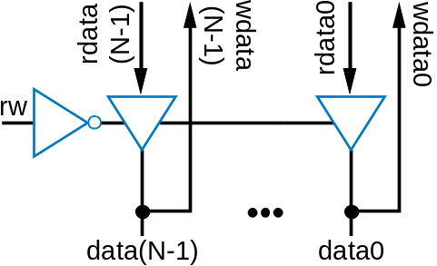
RAM Internal Structure
Let A = log₂M
wdata(N-1)
wdata(N-2)
wdata0
32
data
10
word
bit storage
addr
1024x32
enable
block
r
w
RAM
d0
(aka “cell”)
en
addr0
a0
w
o
r
d
addr1
a1
AxM
d1
decoder
addr(A-1)
a(A-1)
data cell
d(M-1)
word
word
Combining rd and wr data lines
clk
e
enable
enable
en
r
w
data
r
w
to all cells
RAM cell
rdata(N-1)
rdata(N-2)
rdata0
Similar internal structure as register file
  Decoder enables appropriate word based on address inputs
  rw controls whether cell is written or read
  rd and wr data lines typically combined

Slide 7
Question (AP)
Given the following RAM content, if enable is 1, addr = 011, and rw = 0 (read), what is the output (rdata)?
  10111011
  00111101
  1011
  1111
  ☹
wdata3 | wdata2 | wdata1 | wdata0
0 | 1 | 1 | 0
0 | 0 | 0 | 0
1 | 1 | 1 | 1
1 | 0 | 1 | 1
1 | 1 | 1 | 1
0 | 0 | 0 | 1
0 | 0 | 1 | 0
1 | 1 | 1 | 1

Slide 8


Static RAM (SRAM)
SRAM cell
“Static” RAM cell
  Maintains stored bit as long as power is supplied
  6 transistors
Writing
  When not enabled, value d loops around inverters
    That loop is where a bit stays stored
  When enabled, the data bit value enters the loop
    data is the bit to be stored in this cell
    data’ enters on other side
data
data’
d
cell
d’
word
0
enable
SRAM cell
data
data’
1
0
d
1
0
word
1
enable
data
data’
d
cell
1
d’
0
word
0
enable

Slide 9




Static RAM (SRAM)
Reading
  Somewhat trickier
  When rw set to read, the RAM logic sets both data and data’ to 1
  The stored bit d will pull either the left line or the right bit down slightly below 1
  “Sense amplifiers” detect which side is slightly pulled down
SRAM cell
data
data’
1
1
d
1
0
word
1
1
<1
enable
To sense amplifiers

Slide 10
Dynamic RAM (DRAM)
“Dynamic” RAM cell
  1 transistor (rather than 6)
  Large capacitors used to store bit
    Capacitor discharges over time
    Must “refresh” regularly, by reading d and then writing it right back
Write
  Transistor conducts, data voltage level gets stored on top plate of capacitor
Read (destructive)
  Set data to somewhere between 0 and 1, then sense
DRAM cell
data
c
ell
word
enable
d
capacitor
slowly
discharging
data
enable
d
discharges

Slide 11
Comparing Memory Types
Register file
  Fastest, but biggest
SRAM
  Fast, more compact than register file
DRAM
  Slowest (and refreshing takes time)
  Very compact
Use register file for small items, SRAM for large items, and DRAM for huge items
DRAM’s big capacitor requires a special chip design process, so DRAM is often on a separate chip
MxN Memory
implemented as a:
register
file
SRAM
DRAM
Size comparison for same
number of bits (not to scale)

Slide 12


Reading and Writing a RAM
clk
Writing
  Put addr on addr lines, data on data lines, set rw=1, en=1
Reading
  Set addr and en lines, but put nothing (Z) on data lines, set rw=0, data will appear on data lines
Don’t forget to obey setup and hold times
1
2
3
clk
addr
9
13
9
addr
valid
setup
time
data
500
999
Z
500
data
valid
hold
Z
500
time
r
w
1 means write
r
w
setup
en
time
access
RAM[9]
RAM[13]
time
now equals 500
now equals 999

Slide 13
Read-Only Memory (ROM)
Memory that can only be read from, not written to
  Data lines are output only
  No need for rw input
Choose ROM over RAM if stored data won’t change (or won’t change often)
  Example: your Basys board

Slide 14
RAM vs. ROM
RAM
ROM
32
data
32
Can be written to
More compact
Nonvolatile
Maybe faster
  Especially compared to RAM
Low power
10
data
addr
10
1024x32
r
w
1024
×
32
addr
ROM
R
A
M
en
en

Slide 15
ROM Internal Structure
No data input line
32
data
10
addr
1024x32
Let A = log₂M
ROM
en
word
bit storage
enable
block
ROM block symbol
d0
(aka “cell”)
addr0
a0
w
o
r
d
addr1
a1
AxM
d1
decoder
addr(A-1)
a(A-1)
data
d(M-1)
word
word
clk
e
enable
enable
en
data
ROM cell
rdata(N-1)
rdata(N-2)
rdata0

Slide 16
ROM Types
If a ROM can only be read, how are the stored bits stored in the first place?
  Storing bits in a ROM known as programming
  Several methods
    Mask-Programmed ROMs
    Fuse-Based Programmable ROM
    Erasable Programmable ROM (EPROM)
    Electronically-Erasable Programmable ROM (EEPROM)
    Flash Memory

Slide 17
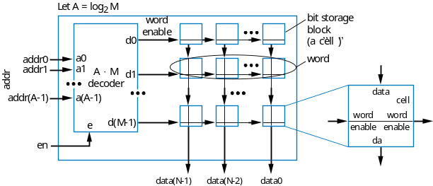
Mask-Programmed ROM
Bits are hardwired as 0s or 1s during chip manufacturing
  2-bit word on right stores “10”
  word enable (from decoder) simply passes the hardwired value through transistor
Notice how compact, and fast, this memory would be
1
data line
0
data line
cell
cell
word
enable

Slide 18
Fuse-Based Programmable ROM
Each cell has a fuse
  A special device, known as a programmer, blows certain fuses (using higher-than-normal voltage)
  Those cells will be read as 0s
  Cells with unblown fuses will be read as 1s
  2-bit word on right stores “10”
Also known as One-Time Programmable (OTP) ROM
1
data line
1
data line
cell
cell
word
enable
fuse
blown fuse

Slide 19
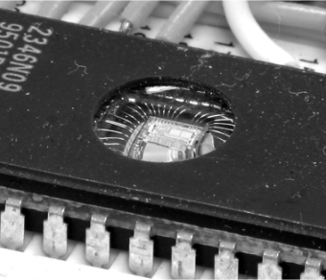
Erasable Programmable ROM (EPROM)
Uses “floating-gate transistor”
  Special programmer device uses higher-than-normal voltage to cause electrons to tunnel into the gate
  Electrons become trapped in the gate
    Only done for cells that should store 0
    Other cells (no trapped electrons) will be 1
To erase, shine ultraviolet light onto chip
  Gives trapped electrons energy to escape
floating-gate
transistor
data line
data line
c
ell
c
ell
1
1
0
word
e
-
e
-
enable
trapped electrons

Slide 20
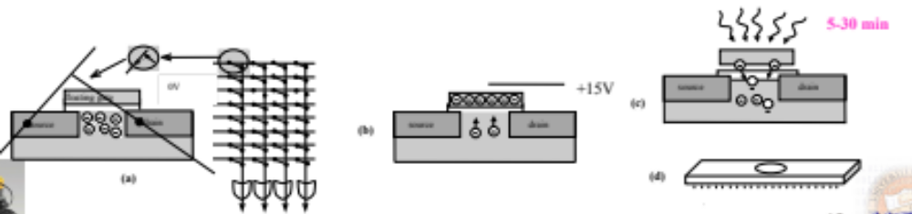
More on EPROM

Slide 21
EEPROM & Flash Memory
Electronically-Erasable Programmable ROM
  Similar to EPROM
  Uses floating-gate transistor, electronic programming to trap electrons in certain cells
    But erasing done electronically, not using UV light
    Erasing done one word at a time
Flash memory
  Like EEPROM, but all words
  (or large blocks of words) can be
  erased simultaneously
  Became very common starting in late
  1990s
32
data
10
addr
en
1024x32
EEPROM
write
busy

Slide 22
EEPROM & flash Memory
Main types of flash memory
  NOR types (faster)
    Cells are connected in parallel to bit lines (resembling NOR gates)
    A single word can be written/read independently
  NAND types (denser)
    Cells are connected in series (resembling NAND gates)
    Must read/write in blocks
EEPROM and flash memory are in-system programmable
  Can be programmed with new stored bits while in the system in which the ROM operates
    Requires bi-directional data lines, and write control input
    Also need busy output to indicate that erasing is in progress – erasing takes some time

Slide 23
ROM Example: Using Flash Memory
Want to record your message
  When rec = 1, record digitized sound in locations 0 to 4095
  When play = 1, play those stored sounds to digital-to-analog converter
What type of memory?
  Should store without power supply
    ROM, not RAM
  Should be in-system programmable
    EEPROM or Flash
    Not EPROM, OTP ROM, or mask-programmed ROM
  Will always erase entire memory when reprogramming
    Flash better than EEPROM

Slide 24
ROM Example: Using Flash Memory
System design
4096x16 Flash
“We’re not home.”
data
addr
rw
en
erase
busy
16
analog-to-
12
digital
ad_buf
Ra
Rrw
Ren
er
bu
digital-to-
converter
analog
ad_ld
processor
converter
da_ld
rec
play
record
play
microphone
speaker

Slide 25
ROM Example: Using Flash Memory
HLSM
  Once rec = 1, begin erasing flash by setting er = 1
  Wait for flash to finish erasing by waiting for bu = 0
  Execute loop that sets local register a from 0 to 4095, reading analog-to-digital converter and writing to flash for each
4096x16 Flash
analog-to-
16
digital
ad_buf
12
Ra
Rrw
Ren
er
bu
digital-to-
converter
analog
ad_ld
processor
converter
da_ld
rec
record
play
microphone
speaker
Local register: a, Rareg (13 bits)
bu
a<4096
S
T
bu’
U
a:=‘0’
er:=‘0’
ad_ld:=‘1’
er:=‘1’
ad_buf:=‘1’
Rareg:=a
V
rec
Rrw:=‘1’
(a<4096)’
Ren:=‘1’
a:=a+1

Slide 26
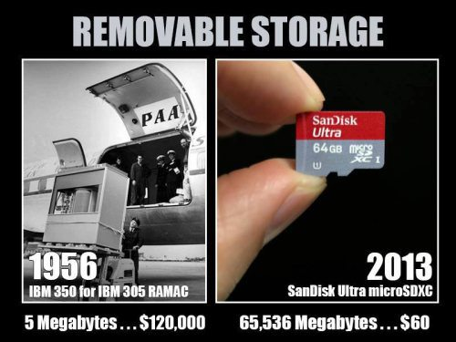
Memory Technology Scaling

Slide 27
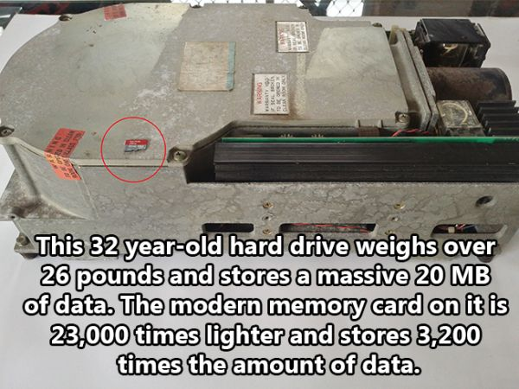
More Technology Scaling

Slide 28
Blurring Distinction Between RAM and ROM
Some ROMs now act almost like RAMs
  EEPROM and flash memory are in-system programmable
    Essentially means that writes are slow
    Also, number of writes may be limited (a few million times, maybe)
Some RAMs act almost like ROMs
  Non-volatile RAMs: Can save their data without the power supply
    One type: Built-in battery, may work for up to 10 years
    Another type: Includes ROM backup for RAM – controller writes RAM contents to ROM before turning off
New memory technologies evolving that merge RAM and ROM benefits
  e.g., MRAM

Slide 29
Today’s Objective
To learn about memory components and their characteristics
  RAM
  ROM

Slide 30
Question
You are asked to design a memory unit consisting of 1024 32-bit words with a budget of $10. Assume you are given the following prices for each bit of memory technology. What is the fastest technology you can afford?
  Register files
  SRAM
  DRAM
  There is more than one feasible option
  ☹
Technology | $ per bit
Register File | 0.01
SRAM | 0.0001
DRAM | 0.000001

